Slide 1
HIGH CLOUD AIRLINE ANALYSIS

Slide 2
Introduction
01
Objective
CONTENTS
02
Course of the Project
03
Key Takeaways
04
05
Conclusion

Slide 3
Introduction of the Project
This project is aimed to extract the valuable insights from the data given by the company from the year 2008 to 2013 to improve the operations and performance of High Cloud Airlines through data analysis.
In this project we mainly focused on building KPI’s and Visuals of,
Load factor
Top carriers
Top routes
Efficiency of the company
Creating overall dashboard

Slide 4
Objective
Analysis of High Cloud Airline data is to gain domain knowledge of aviation sector (like how it works) and focusing on managing and analyzing the dataset by data cleaning, data modelling and data visualization using BI tools like Microsoft Excel, Power BI, Tableau and MySQL.
Ultimately the goal is to provide the company an useful and practical suggestions on strategic decision making to improve efficiency and performance for different aspects of airline operations such as route optimization, customer service, etc.

Slide 5
Course of the Project
Data cleaning and data modelling using Excel, Power query editor and MySQL.
Due to large volume of dataset it impacted our work flow like import time, long loading time, etc.
Created KPI’s and Visuals using pivot charts, Power BI and Tableau.
Calculated load factor (i.e. Transported passengers/available seats) on year, quarter, monthly basis and also on carrier name basis.
Identified the top 10 carrier names and routes based on passenger preference.
Compared the load factor on weekdays and weekends.
Finally we created 3 dashboards using excel, Power BI and Tableau.

Slide 6
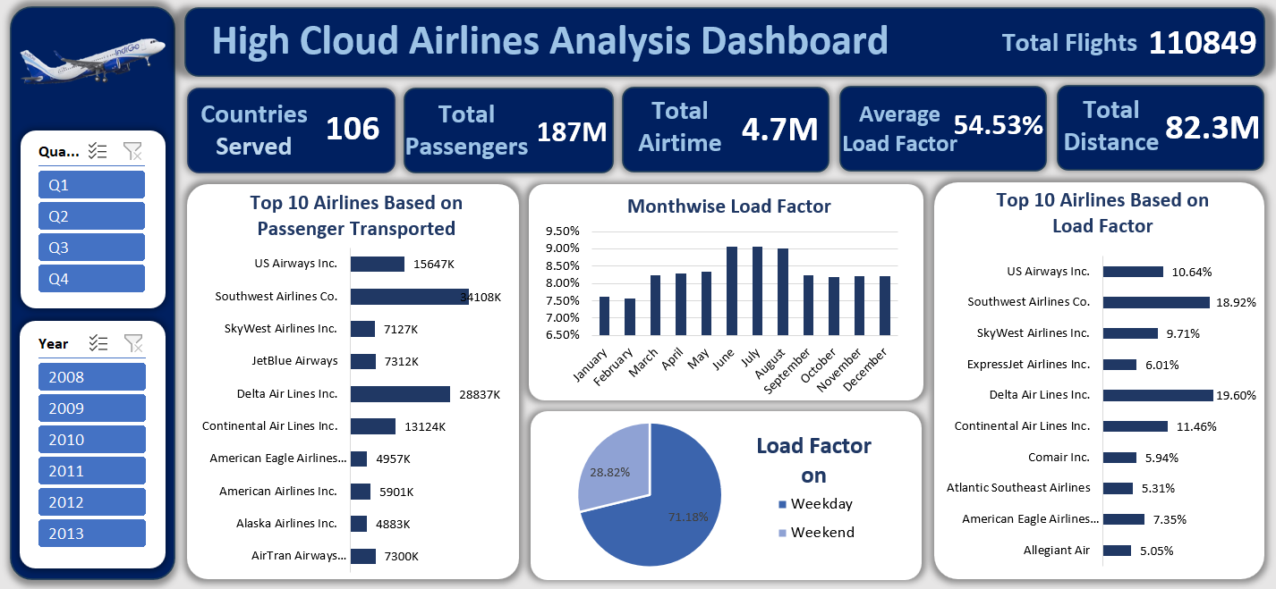
Excel Dashboard
Replace with your own text

Slide 7
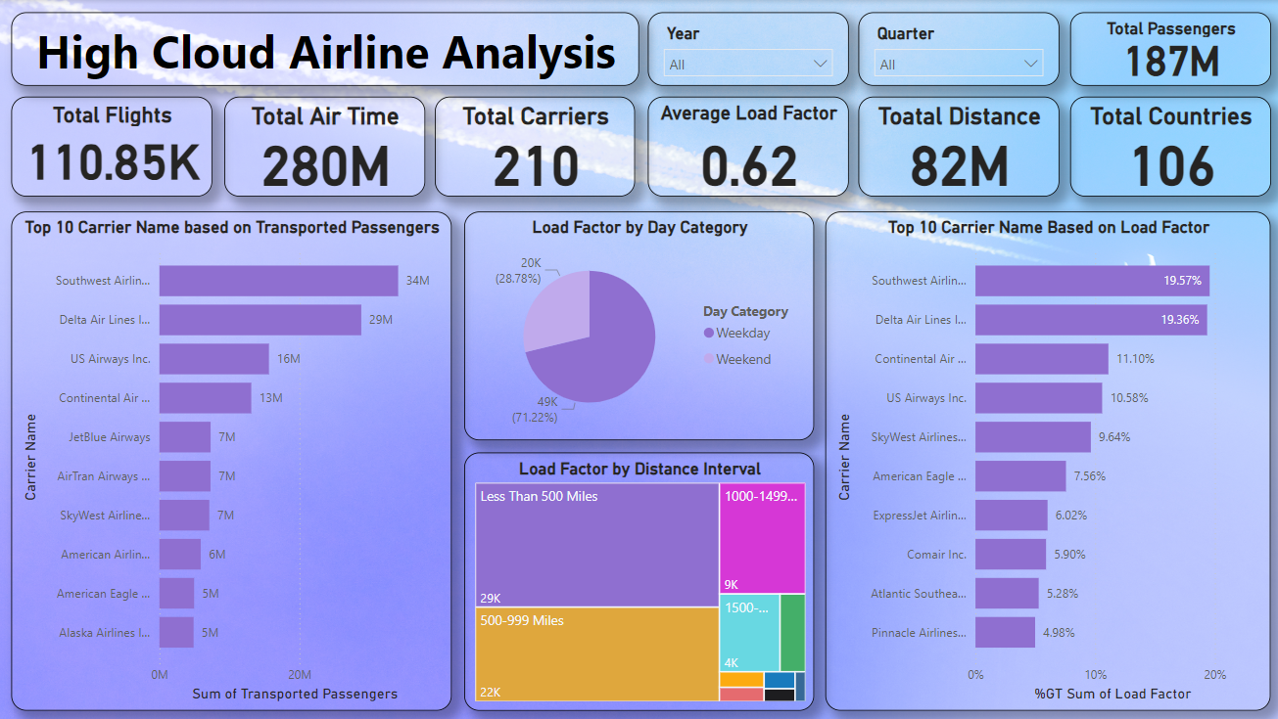
Power BI Dashboard

Slide 8
Key Takeaways
1. Optimizing Load Factor:
One of the key metrics analyzed is the Load Factor, which measures the efficiency of the airline in filling seats. A high load factor is crucial for profitability. This analysis can help the airline identify under-performing routes or periods where seat capacity isn’t fully utilized.
Actionable Suggestion: Focus on improving load factor by adjusting pricing strategies during low demand periods, promoting more profitable routes, and increasing marketing efforts for less popular flights.
2. Identifying Top Carriers and Routes:
By identifying top carriers and top routes, you can assess which carriers and routes are generating the highest revenue and attracting the most passengers.
Actionable Suggestion: The airline can strategically allocate resources to the most profitable routes and assess opportunities for new partnerships with high-performing carriers. Additionally, expansion into top-performing routes should be considered for more fleet deployment.
3. Improving Operational Efficiency:
Analyzing the efficiency of various operations helps highlight areas for improvement. Metrics such as on-time performance, fuel consumption, and employee productivity provide insight into operational bottlenecks.
Actionable Suggestion: Invest in technologies that streamline scheduling and enhance fuel efficiency. Train employees to handle critical tasks more efficiently, reducing delays and operational costs.

Slide 9
Key Takeaways
4. Data-Driven Decision-Making:
Through the data cleaning, modeling, and visualization process, valuable insights can be derived from historical data, enabling High Cloud Airlines to make strategic decisions based on facts, not just intuition.
Actionable Suggestion: Adopt a more data-driven approach across all departments by providing teams with access to interactive dashboards and reports, which can improve strategic decision-making, resource allocation, and customer satisfaction.
5. Route Optimization:
The analysis of routes and their profitability can help determine underperforming routes, which may be candidates for adjustment or discontinuation.
Actionable Suggestion: Implement dynamic pricing and route optimization strategies based on seasonal trends, customer preferences, and competitor analysis. Investing in new technologies like machine learning models can enhance decision-making for route planning.
6. Customer Service and Satisfaction:
Understanding operational inefficiencies and passenger satisfaction levels can help improve customer service.
Actionable Suggestion: Implement a more customer-centric approach by improving service on popular routes and focusing on areas where customers have shown dissatisfaction (e.g., punctuality, baggage handling).
7. Scenario Analysis for Strategic Planning:
The project also opens the possibility of conducting scenario analysis based on different operational factors like fuel costs, market conditions, and customer demand, allowing for better forecasting.
Actionable Suggestion: Create what-if scenarios that predict future outcomes based on different strategic decisions (e.g., increasing fares, reducing fleet size) to guide long-term planning and risk management.

Slide 10
Conclusion
In today’s highly competitive aviation sector, airlines has significantly transformed due to big data analytics.
The analysis of High Cloud Airline data has given valuable insights that helps to transform the company operations and customer experience.
The comprehensive study of load factor, passenger preferences, top routes, top carriers, weekly trends has helped us to gain the vast knowledge on aviation sector.
By using BI tools like Excel, Power BI helped us to learn how to handle the large dataset, how to build relationship, and how to effectively transform raw data into useful insights for decision making.
Finally by this project we understood the role of data analytics in decision making regarding the future of any business sector.

Slide 11
THANK YOU

